Slide 1
Traveling Route Generation System
Project Status Presentation IV
Zhang Yong, Li Zhihui, Liu Ziyi
10 July, 2019

Slide 2
CONTENTS
Baidu Map API
Data Crawling
Demo Display
Prospect

Slide 3
Baidu Map API
01

Slide 4

Baidu Map API
Google Map API:
Not fit Mainland very well
Not provide transit api
Baidu Map API:
More easy to use
Include transit route api

Slide 5
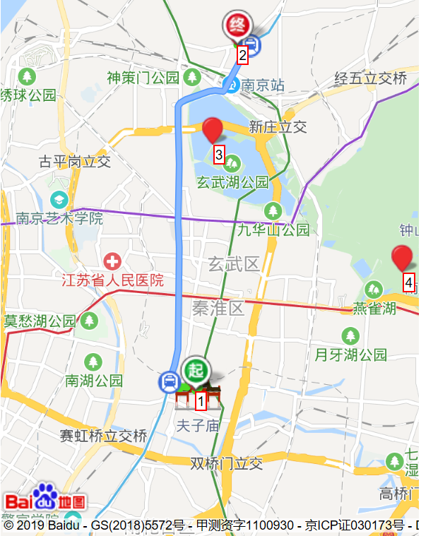
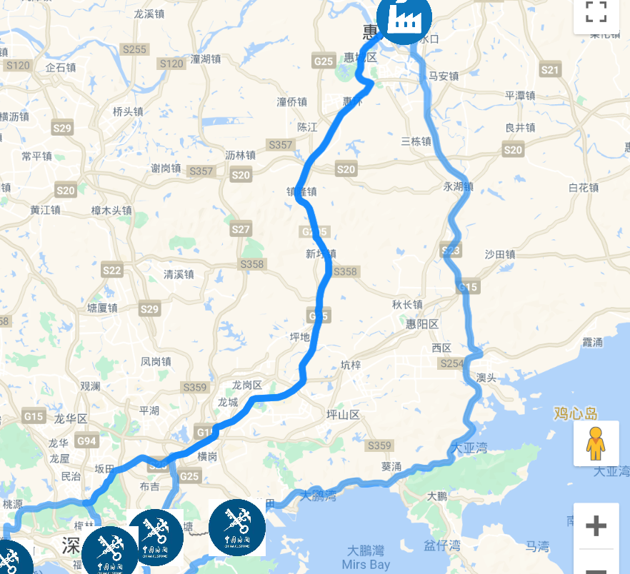
Baidu Map API

Slide 6
Data Crawling
02

Slide 7


Slide 8
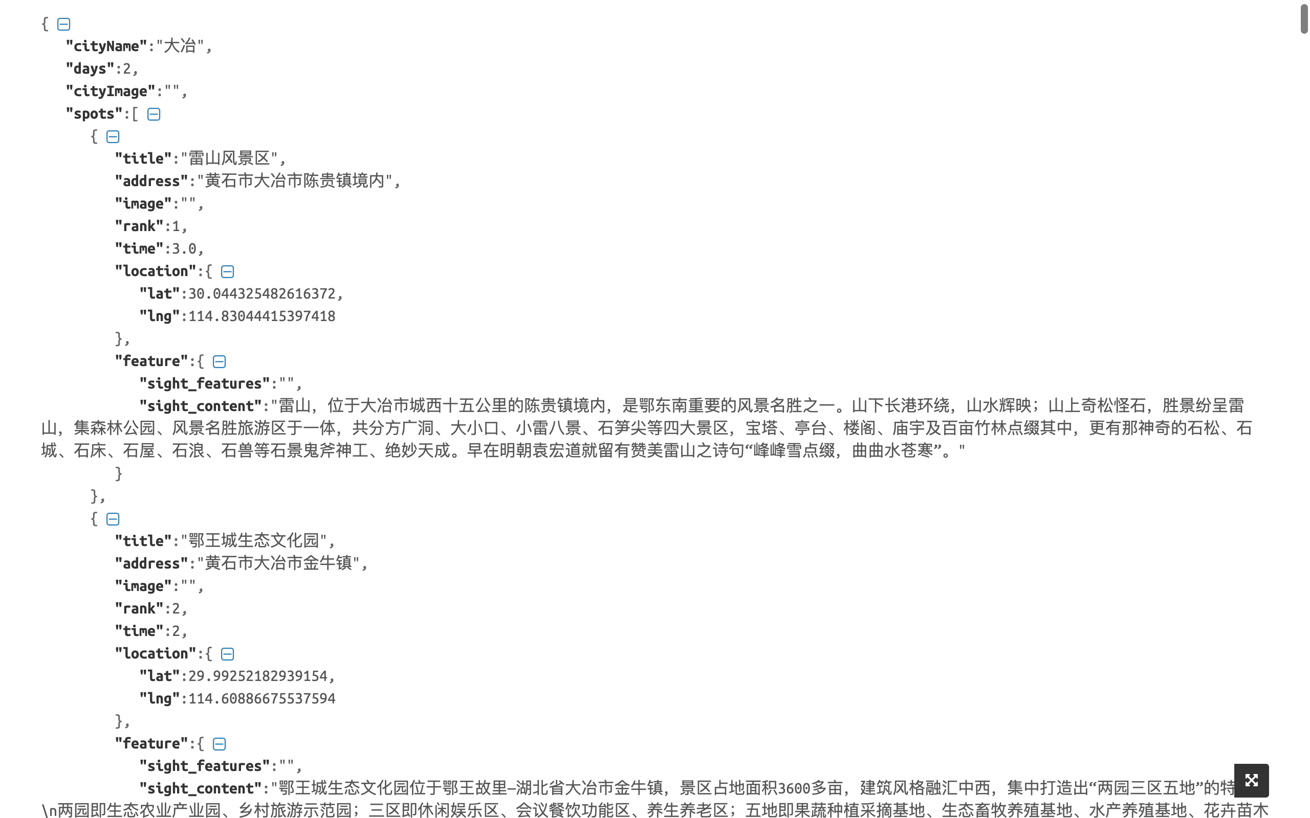

Slide 9
Demo Display
03

Slide 10
